Slide 1
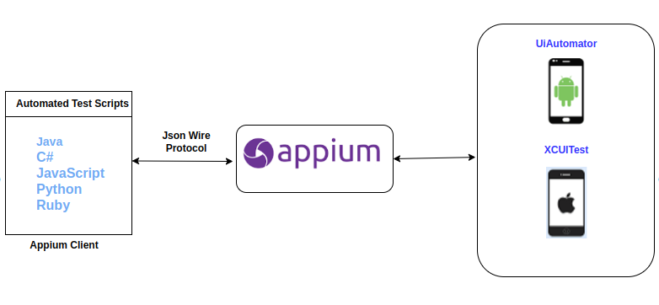
Appium Set Up

Slide 2
1. Download the NodeJs installation packages from this website https://nodejs.org/en/download/ and run the installer. 2. Launch Command prompt 3. Enter the command npm i -g appium 4. It will install appium server
After installing, run the command appium. The result would be

Slide 3
Android Read Device Setup
The Android Real device should be setup with Appium to execute the automation scripts on Mobile. There are few steps to connect Android Real device with Appium,
Preconditions:
1. Java JDK should be installed. 2. Android Studio should be installed. 3. Appium and Appium Inspector should be installed.
Steps:
1. Enable USB Debugging on Android Device:
This is usually found in Settings>Developer Options. If you don't see "Developer Options," you may need to enable it by tapping the "Build number" seven times (more or less based on the phone) in the "About phone" section.
2. Connect your Android device to your computer using a USB cable. 3. Check your ADB connection - Ensure that the Android Debug Bridge (ADB) recognizes your connected device. You can check this by running adb devices in the command prompt or terminal.

Slide 4
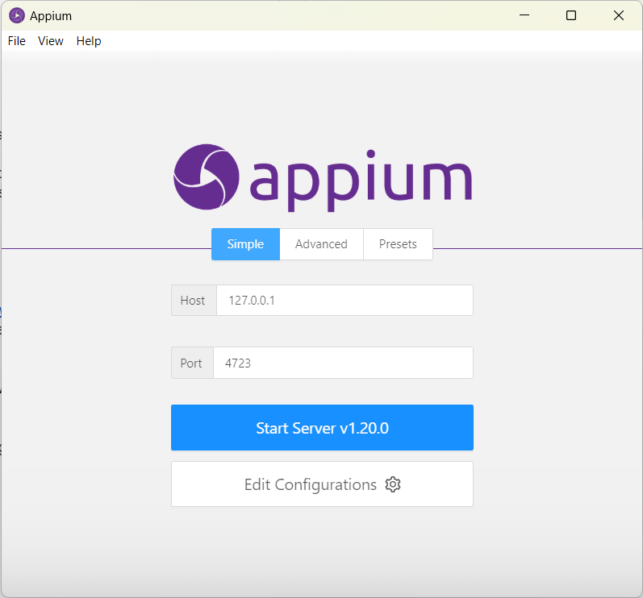
Steps to connect a real android device with Appium:
1. Launch Appium Server GUI and start the server with the checkbox Allow CORS is checked in Advanced tab

Slide 5
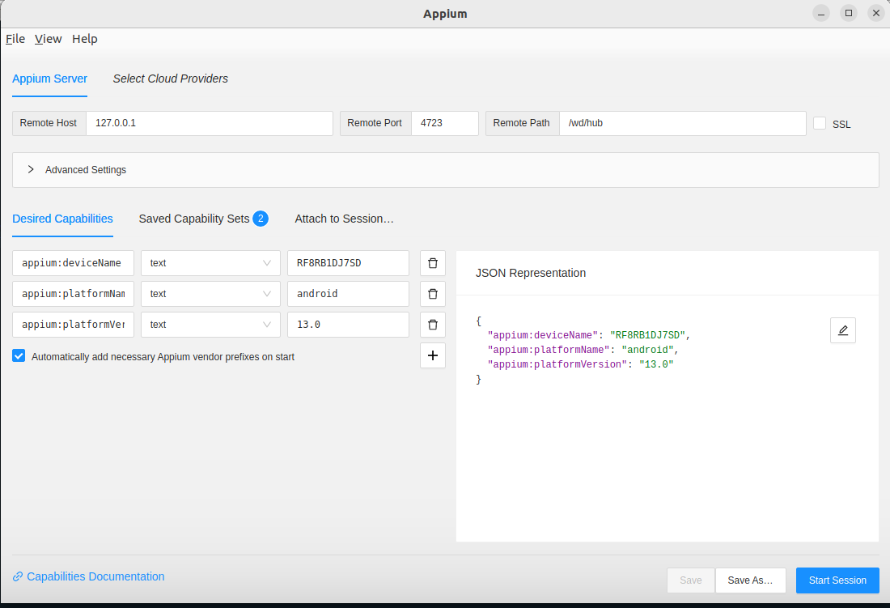
2. Launch Appium Inspector and enter the host and port values that matches the Appium Server and set Remote Path as “/wd/hub/” and enter the desired capabilities(can check via https://appium.io/docs/en/2.2/guides/caps/) that matches the Real devices connected via USB cable like below. We have

Slide 6
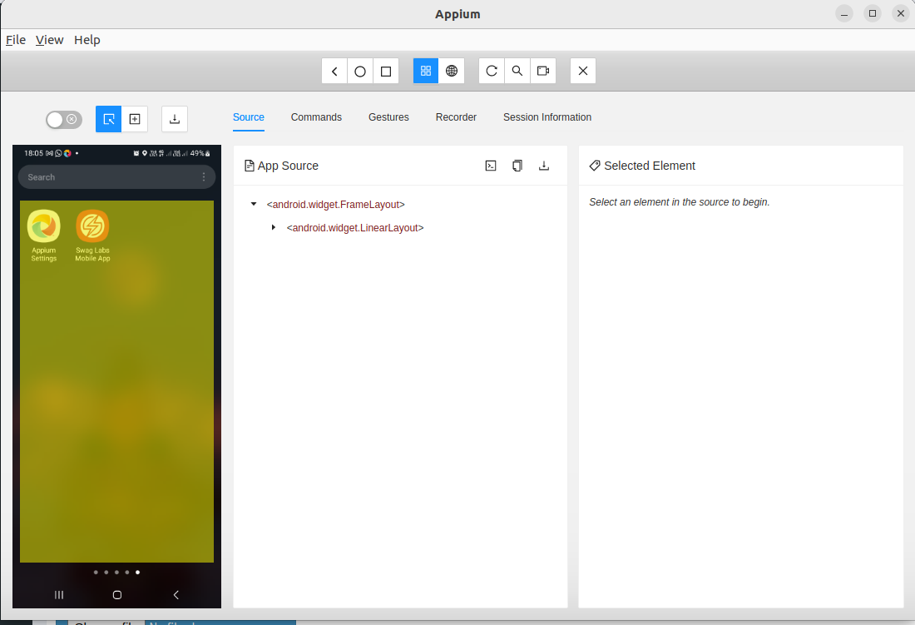
3. Click “Start Session” button and the output should be like below image

Slide 7
Thank You

